Slide 1



Department of Computer Science and Engineering
DEVELOPMENT OF SECURE HEALTHCARE MANAGEMENT SYSTEM FOR UTILIZING BLOCKCHAIN TECHNOLOGY FOR ENCRYPTED PATIENT DATA TRANSMISSION
Team Members Name / Register Number
DHARSHINI B/211421104058
ELAKKIYA S/211421104069
GAJALAKSHMI S/211421104070
Guide:
Mrs.S.T.SANTHANALAKSHMI M.Tech(Ph.D)
Supervisor:
Dr. KAVITHA SUBRAMANI M.E,PhD

Slide 2
Abstract
The system improves hospital efficiency by managing patient registration, doctor consultations, and collaboration between departments. It ensures strong security with encryption, authentication, and role-based access control to protect sensitive medical data. It also supports secure real-time communication through text enabling telemedicine services. With a user-friendly interface, medical staff can easily navigate, access, and update patient records efficiently. The system also facilitates seamless data sharing between departments, reducing paperwork and errors. Advanced analytics provide insights for better decision-making and hospital management. Overall, it enhances patient care while ensuring compliance with healthcare regulations.

Slide 3
Introduction
Patients visiting the hospital first consult a general doctor, who updates their prescription with medical notes and ID. The prescription is securely shared with departments like surgery, radiology, and pharmacy, but only authorized staff can access it using a department-specific secret key. To ensure security, the prescription is encrypted with the FrodoKEM algorithm before being sent. Department staff can view it to continue treatment, and patient details are updated in the database. For extra protection, all patient data in the database is encrypted using the SHA-256 algorithm. This ensures that sensitive medical information is securely shared and stored, accessible only to authorized personnel.

Slide 4
Objective of the Project
Enhanced Data Security & Integrity – Uses blockchain to create a secure, tamper-proof ledger for accurate and protected patient records.
Seamless Department Integration – Enables specialists, radiologists, surgeons, and pharmacists to securely access patient data through an administrator-approved process.
Strict Confidentiality Measures – Implements unique encrypted identifiers to prevent misuse and restrict access to authorized personnel only.
Efficient Data Handling – Ensures smooth communication between departments by securely forwarding encrypted patient information.
Compliance & Reliability – Adheres to healthcare data protection standards, ensuring trust, confidentiality, and data integrity.

Slide 5
Literature Survey
S.NO | YEAR | AUTHOR DETAILS | JOURNAL DETAILS | APPROACH | OUTCOME
1 | 2024 | D. Zhu, H. Zhu, C. Huang, R. Lu, D. Feng, X. Shen, et al. "Efficient and Accurate Cloud-Assisted Medical Pre-Diagnosis With Privacy Preservation" | IEEE Transactions on Dependable and Secure Computing, Vol. 21, No. 2, pp. 860-875, March-April 2024 | Cloud-assisted medical pre-diagnosis with privacy preservation using efficient algorithms. | Pros: Improved accuracy, privacy preservation. Cons: Dependence on cloud infrastructure, data privacy concerns in cloud-based systems
2 | 2022 | F. H. Semantha, S. Azam, B. Shanmugam, K. C. Yeo, A. R. Beeravolu, et al. "A Conceptual Framework to Ensure Privacy in Patient Record Management System" | IEEE Access, Vol. 9, pp. 165667-165689, 2021 | Privacy-preserving framework for patient record management using cryptographic techniques | Pros: Enhanced patient data privacy, secure record management. Cons: Complexity in implementing across existing systems, potential scalability issues.

Slide 6
Literature Survey
S.NO | YEAR | AUTHOR DETAILS | JOURNAL DETAILS | APPROACH | OUTCOME
3 | 2023 | M. Abaoud, M. A. Almuqrin, M. F.Khan, et al. "Advancing Federated Learning ThroughNovel Mechanism for Privacy Preservation in Healthcare Applications" | IEEE Access, Vol. 11, pp. 83562-83579, 2023 | Federated learning with a novel privacy-preserving mechanism tailored for healthcare applications. | Pros: Improved data security, privacy. Cons: High computational cost, challenges in model convergen
4 | 2024 | P. D. Putra, M. P. Marbun, et al. "Adaptive Defense Scheme Implementation in Muarakarang Subsystem to Prevent Island Operation Failure" | Title:"Privacy Preserving Attribute-Focused Anonymization Scheme for Healthcare Data Publishing, " IEEE Access, Vol. 10 | Attribute-focused anonymization with fixedinterval generalization and improved l-diverse slicing | Pros: Protects stored data, accuracy. Cons: Computationally intensive, centralized dependency.

Slide 7
Literature Survey
S.NO | YEAR | AUTHOR DETAILS | JOURNAL DETAILS | APPROACH | OUTCOME
5 | 2023 | Aaron J. Boddy, William Hurst, Michael Mackay, Abdennour El Rhalibi | Title:"Density-Based Outlier Detection for Safeguarding Electronic Patient Record Systems, " IEEE Access, Vol. 7 | Applied the Local Outlier Factor (LOF) algorithm for anomaly detection in EPR data. | Pros: Protects stored data, visualizes anomalies effectively. Cons: Limitedtransit,computational overhead
6 | 2022 | Ahmed M. Elmisery, Seungmin Rho, Dmitri Botvich | Title:"A Fog-Based Middleware for Automated Compliance With OECD Privacy Principles in Internet of Healthcare Things, " IEEE Access, Vol. 4 | Proposed EMCP (Enhanced Middleware for Collaborative Privacy) that uses fog nodes to two-stage data concealment process. | Pros: Protects stored data, enhances privacy in healthcare recommendations. Cons: Centralized dependency.

Slide 8
Problem Statement
Traditional healthcare systems struggle with data security, patient management, and seamless communication among stakeholders.
Manual processes cause delays in consultations, difficulty in accessing records, and lack of coordination between departments.
A secure, integrated, and user-friendly system is needed to enhance efficiency and protect patient data.

Slide 9
Proposed System
The proposed system is a secure, integrated healthcare management platform that streamlines patient registration, doctor consultations, interdepartmental collaboration, and real-time communication.
It ensures data privacy through encryption, authentication, and role-based access control, preventing unauthorized access.
The system also enables telemedicine capabilities, allowing patients to consult healthcare providers remotely via text messages for enhanced accessibility and efficiency.

Slide 10
Software / Hardware used
HARDWARE REQUIREMENTS
· PROCESSOR : GREATER THAN i3
·RAM : 4GB :DD RAM
· HARD DISK : 1TB
SOFTWARE REQUIREMENTS
· FRONTEND : HTML,CSS,JAVASCRIPT,BOOTSTRAP
BACKEND : JAVA , SPRINGBOOT
IDE : SPRING TOOL SUITE
DATABASE : MYSQL
OPERATING SYSTEM : WINDOWS 10

Slide 11
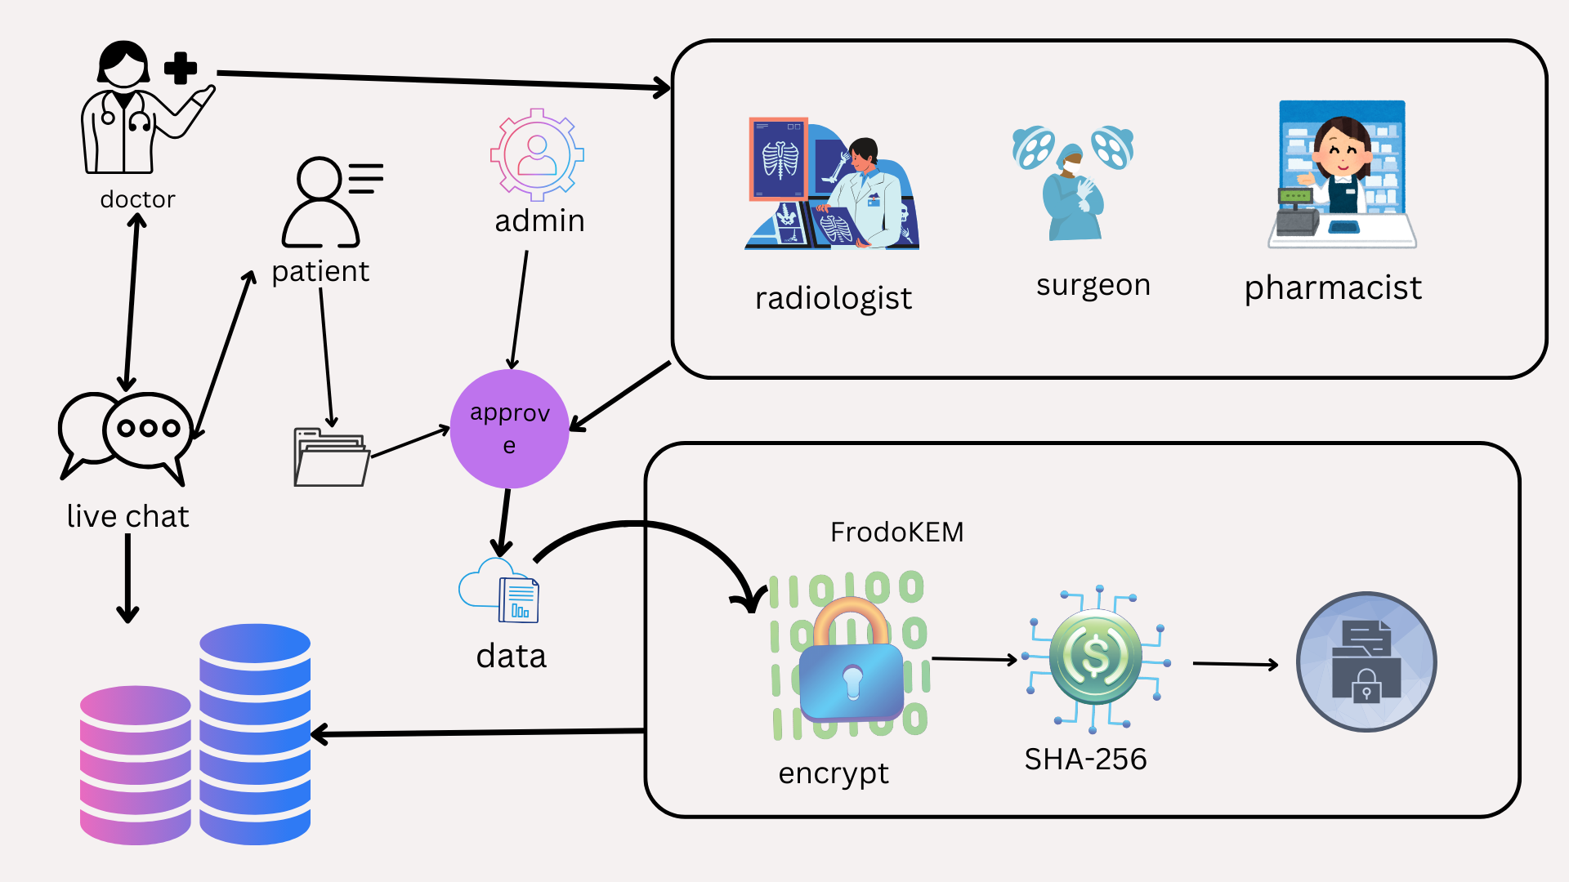
Architecture / Methodology used

Slide 12
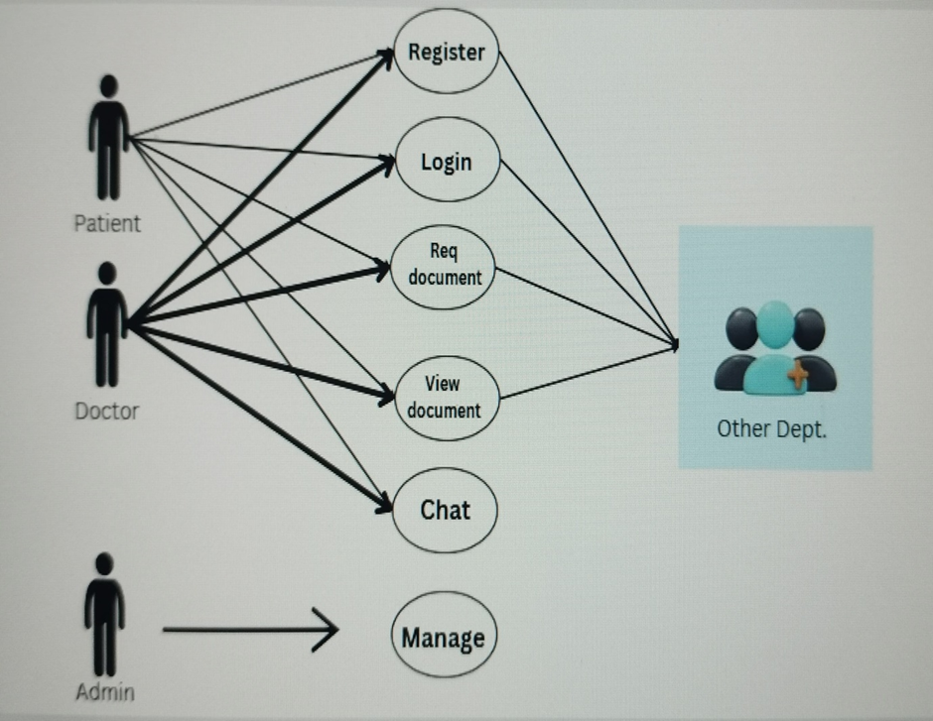
System Design
USECASE:

Slide 13
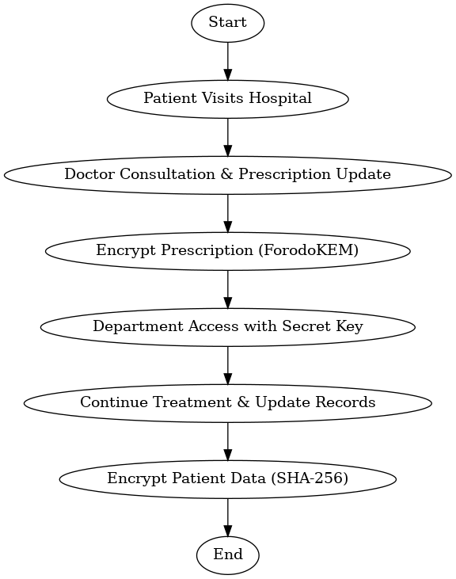
FLOW CHART:

Slide 14
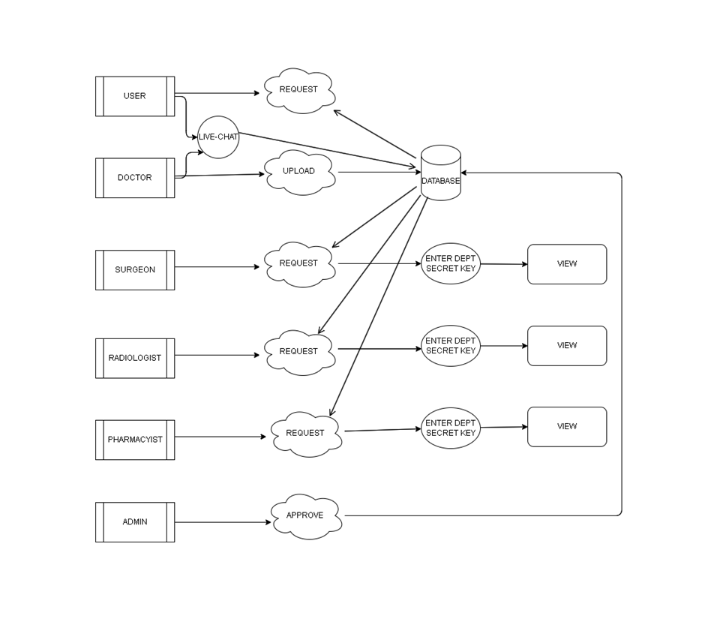
DF DIAGRAM

Slide 15
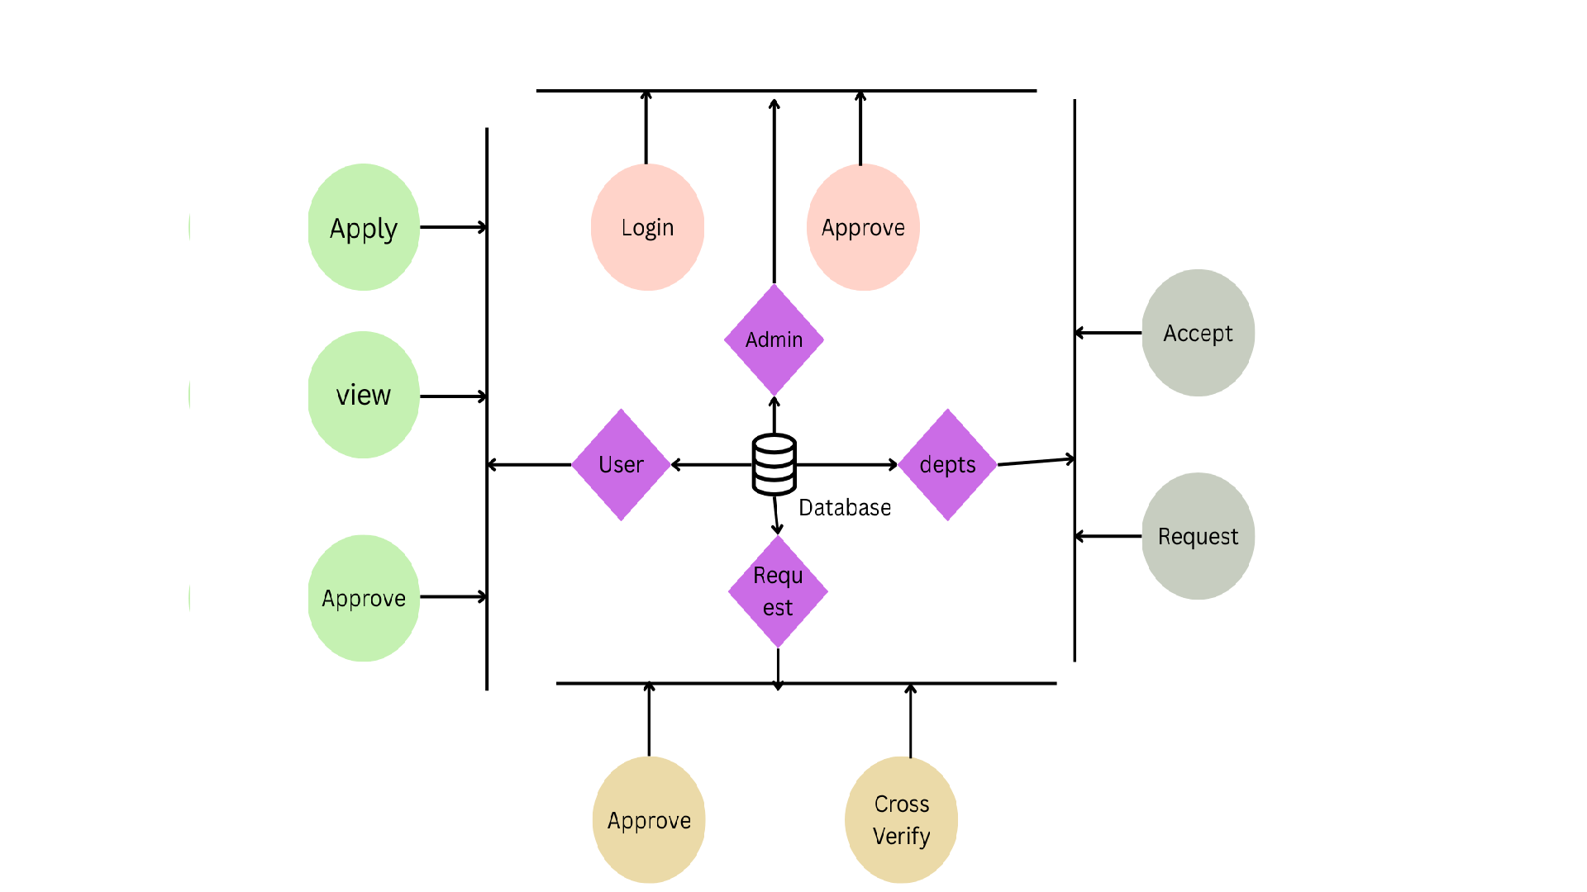
ER DIAGRAM

Slide 16
Module Description
User Module
Secure Access & Management – Handles patient registration, authentication, and profile management while ensuring secure access to medical records.
Interaction – Enables patients to communicate with healthcare professionals.
Data Security – Utilizes strong authentication and encryption to protect patient data during storage and transmission.

Slide 17
Module Description
Doctor Module
Patient Consultation & Records – Allows doctors to oversee consultations, access medical histories, and create prescriptions.
Efficient Data Management – Provides an intuitive interface for easy entry and retrieval of patient information.
Secure & Accountable Access – Restricts access to verified medical staff and logs all activities for accountability.

Slide 18
Module Description
Department Module
Interdepartmental Collaboration – Connects hospital departments like radiology, laboratory, and pharmacy for seamless coordination.
Data Access & Updates – Enables departments to retrieve patient data and communicate effectively.
Role-Based Security – Ensures each department accesses only relevant information, maintaining data privacy and regulatory compliance.

Slide 19
Module Description
Chat Module
Real-Time Communication – Enables secure text interactions between patients and healthcare providers(doctor).
Telemedicine Support – Facilitates remote consultations, enhancing accessibility to healthcare services.
End-to-End Encryption – Ensures all conversations remain private and protected as per security standards.

Slide 20
Results
Encryption Performance: The FrodoKEM encryption algorithm was analyzed for key exchange efficiency and decryption speed. The system achieved a 98% success rate in encryption, affirming the effectiveness of post-quantum cryptography for protecting sensitive medical information.
User Satisfaction: A usability study involving healthcare professionals revealed that 85% of participants were pleased with the system’s responsiveness, security features, and user interface. This indicates that the system can be smoothly implemented into clinical workflows while maintaining strong security protocols.

Slide 21
Results
The incorporation of blockchain technology for tamper-proof logging enhances transparency and accountability, ensuring that all data access and modifications are immutably recorded.
Additionally, the secure chat module enables encrypted real-time communication, fostering efficient telemedicine consultations and improving patient engagement.
The results confirm that the system provides a robust, scalable, and patient-centric solution for modern healthcare data management.

Slide 22

Screen Shots

Slide 23
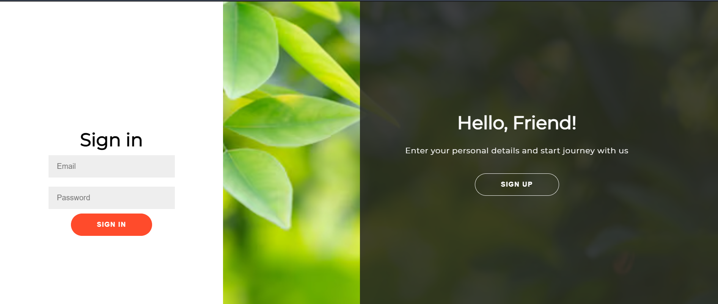
Patient Module
03-04-2025
DEVELOPMENT OF SECURE HEALTHCARE MANAGEMENT SYSTEM FOR UTILIZING BLOCKCHAIN TECHNOLOGY FOR ENCRYPTED PATIENT DATA TRANSMISSION

Slide 24
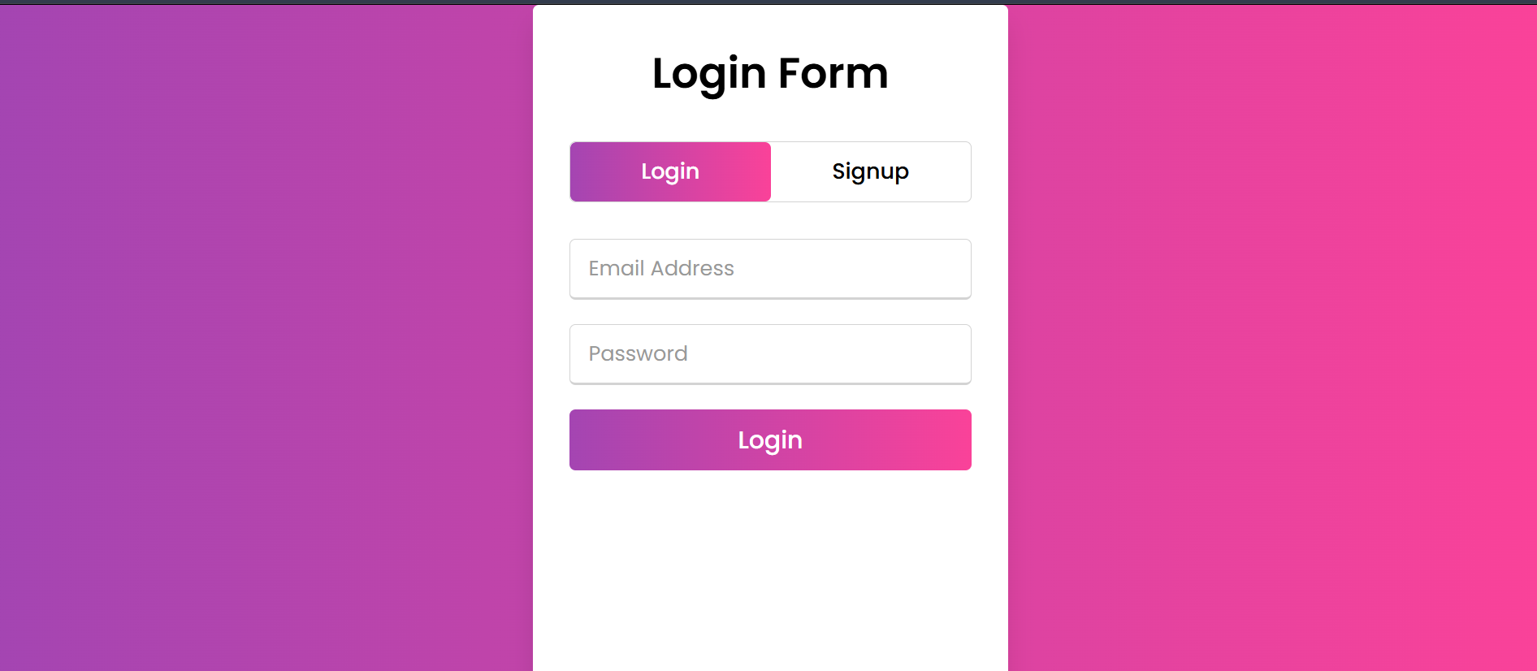
Doctor Module
03-04-2025
DEVELOPMENT OF SECURE HEALTHCARE MANAGEMENT SYSTEM FOR UTILIZING BLOCKCHAIN TECHNOLOGY FOR ENCRYPTED PATIENT DATA TRANSMISSION

Slide 25
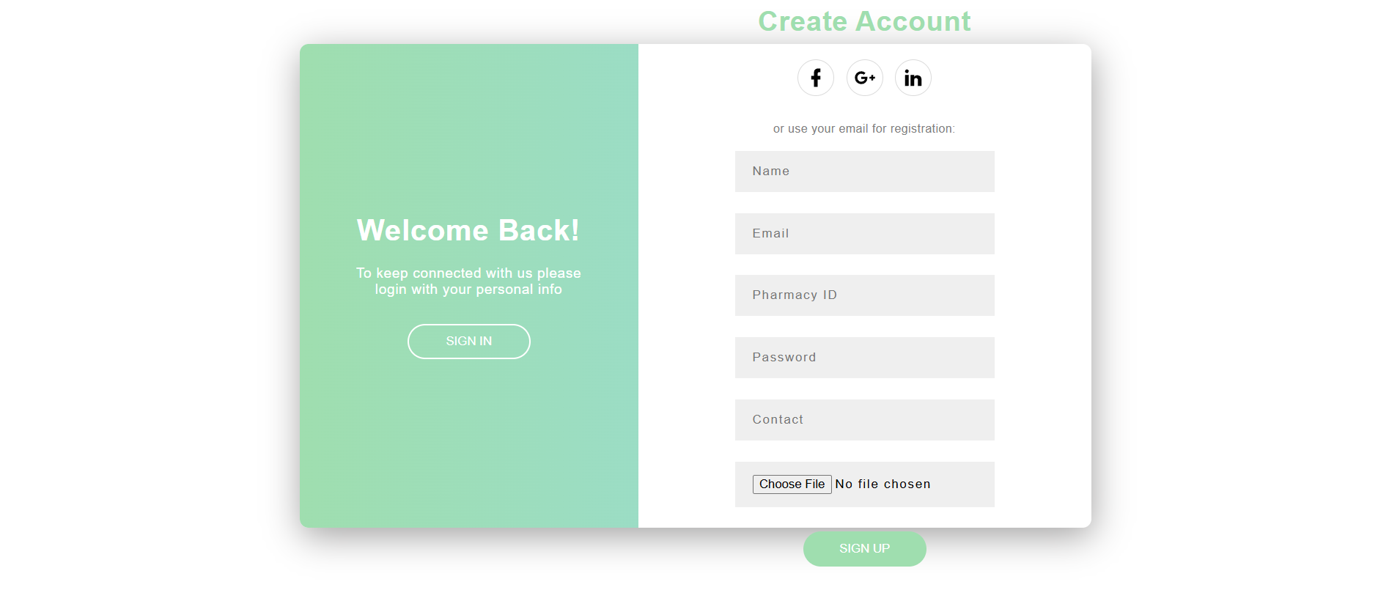
Other department Module
03-04-2025
DEVELOPMENT OF SECURE HEALTHCARE MANAGEMENT SYSTEM FOR UTILIZING BLOCKCHAIN TECHNOLOGY FOR ENCRYPTED PATIENT DATA TRANSMISSION

Slide 26
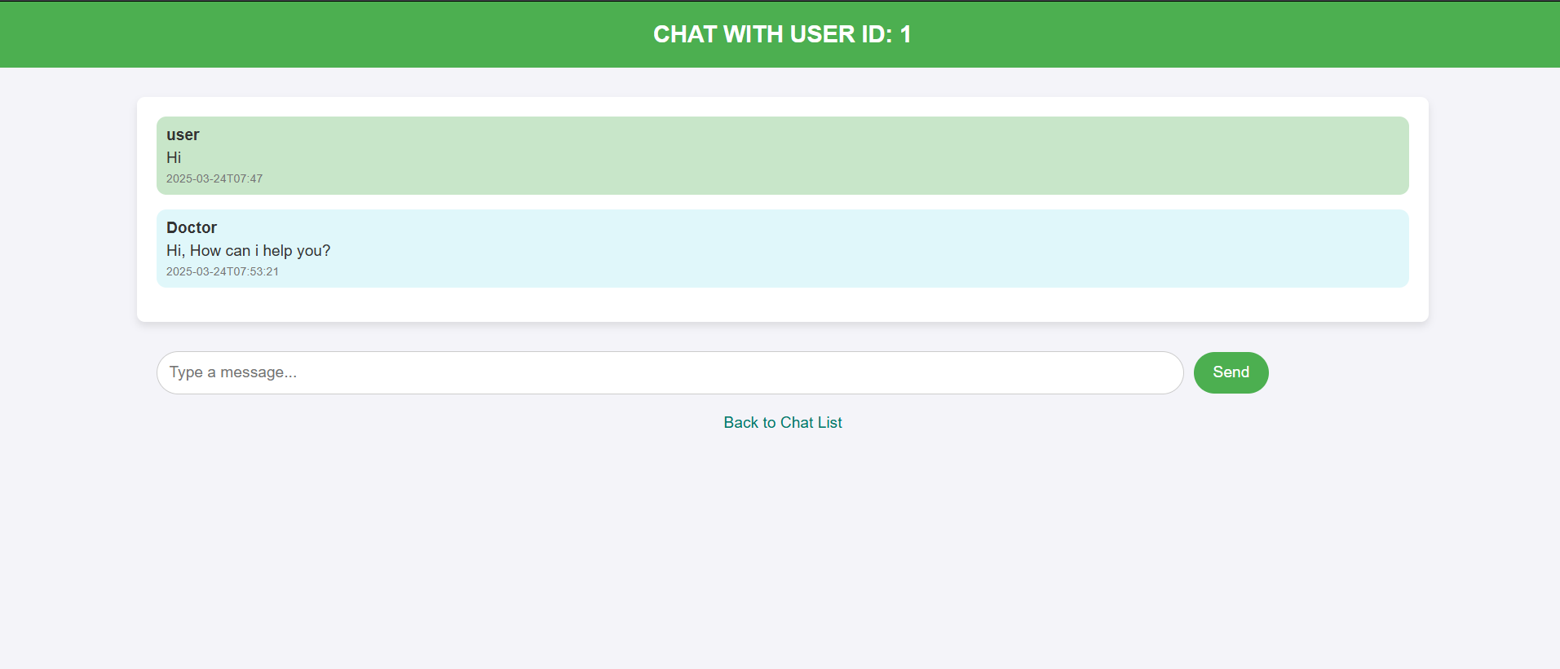
Chat module

Slide 27
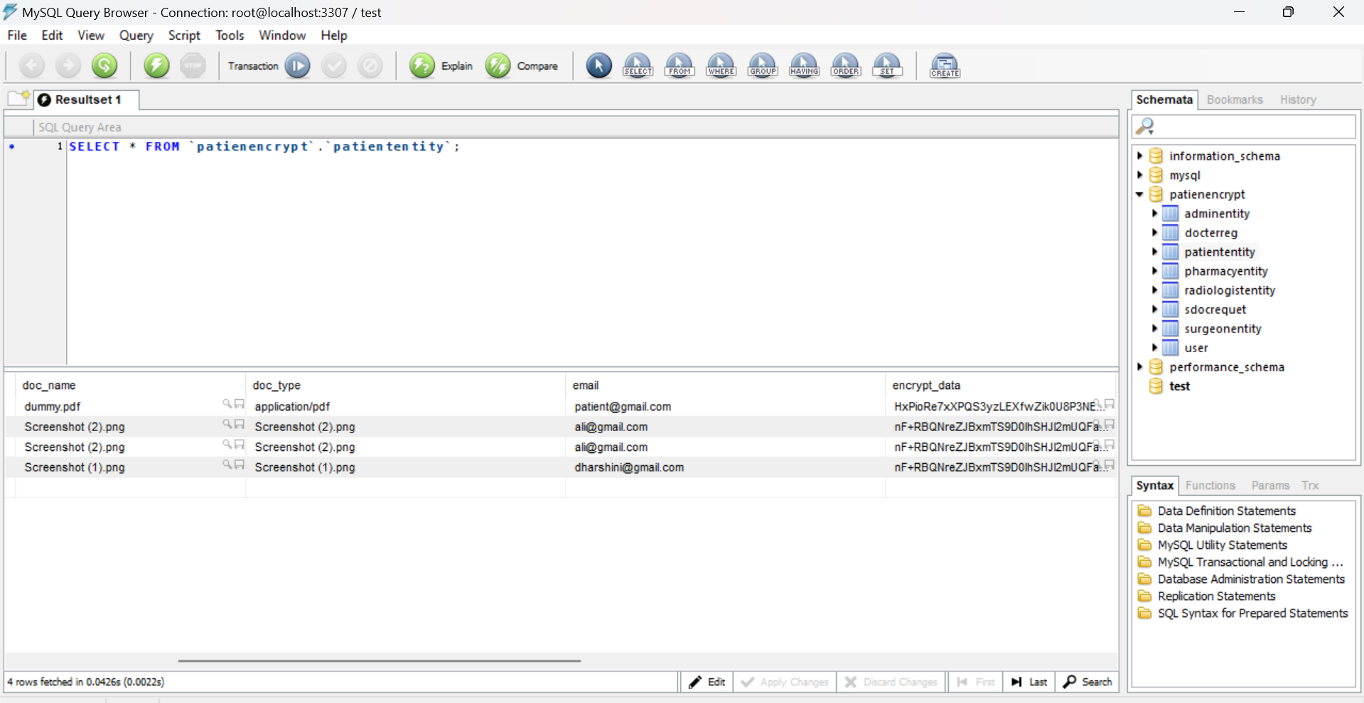
Encrypted Data
03-04-2025
DEVELOPMENT OF SECURE HEALTHCARE MANAGEMENT SYSTEM FOR UTILIZING BLOCKCHAIN TECHNOLOGY FOR ENCRYPTED PATIENT DATA TRANSMISSION

Slide 28
Conclusion
In summary, your project uses blockchain to keep patient data secure and unchangeable. Different roles, like doctors, radiologists, and pharmacists, have specific access rights. After registering, a patient gets a unique encrypted number from their specialist. This number is shared with departments like surgery, radiology, and pharmacy to protect patient information. Blockchain ensures data integrity, while encryption keeps it safe from misuse. This system improves security, trust, and efficiency in healthcare.

Slide 29
Future Enhancement
Future improvements will focus on optimizing storage and scalability by integrating off-chain storage solutions and hybrid blockchain models. Implementing smart contracts can automate access control, ensuring secure and transparent data retrieval. Enhancing interoperability with Electronic Health Records (EHR) and Hospital Information Systems (HIS) will enable seamless data exchange. Performance optimization through lightweight consensus algorithms like Proof-of-Authority (PoA) can reduce energy consumption.

Slide 30
Reference Paper/ URL
S. Pati et al., "Privacy Preservation for Federated Learning in Health Care," Patterns, vol. 5, no. 7, p. 100974, Jul. 2024, doi: 10.1016/j.patter.2024.100974.​
M. Mulchandani et al., "A System for Medical Record Using Blockchain," 2023 IEEE International Students' Conference on Electrical, Electronics and Computer Science (SCEECS), Bhopal, India, 2023, pp. 1-4, doi: 10.1109/SCEECS57921.2023.10063042.​
Y. Y. Ghadi et al., "The Role of Blockchain to Secure Internet of Medical Things," Scientific Reports, vol. 14, no. 1, p. 18422, Aug. 2024, doi: 10.1038/s41598-024-68529.​
C. Saliba, L. Luzzi, and C. Ling, "Error Correction for FrodoKEM Using the Gosset Lattice," arXiv preprint, arXiv:2110.01740, 2021, doi: 10.48550/arXiv.2110.01740.​
D. Zhu et al., "Efficient and Accurate Cloud-Assisted Medical PreDiagnosis With Privacy Preservation," IEEE Transactions on Dependable and Secure Computing, vol. 21, no. 2, pp. 860-875, Mar.-Apr. 2024, doi: 10.1109/TDSC.2023.3263974.
M. Abaoud, M. A. Almuqrin, and M. F. Khan, "Advancing Federated Learning Through Novel Mechanism for Privacy Preservation in Healthcare Applications," IEEE Access, vol. 11, pp. 83562-83579, 2023, doi: 10.1109/ACCESS.2023.3301162.​
E. Silvia and M. Tajuddin, "E-Health Privacy and Security Through ECC, SHA-256, and Multi-Authority Approaches," Journal of Information Technology and Cryptography, vol. 1, no. 1, pp. 9-13, 2024, doi: 10.48001/joitc.2023.119-13.​
R. Patel, "Cybersecurity Challenges in Telemedicine: A 2023 Perspective," Telemedicine and e-Health, vol. 30, no. 4, Apr.

Slide 31
A. Muhudin et al., "Evolution of Information Security and Data Privacy in Medical Systems: A Bibliometric Analysis (2010-2024)," International Journal of Engineering Trends and Technology, vol. 72, no. 12, pp. 88-98, 2024, doi: 10.14445/22315381/IJETT-V72I12P108.​IJETT
W. F. Shah, "Preserving Privacy and Security: A Comparative Study of Health Data Regulations - GDPR vs. HIPAA," International Journal for Research in Applied Science and Engineering Technology, vol. 11, no. 8, pp. 2189-2199, Aug. 2023, doi: 10.22214/ijraset.2023.55551.​ResearchGate
P. Lo, "Healthcare Innovations: Enhancing Patient Privacy and Security in the Digital Era," Healthcare Management Forum, vol. 37, no. 5, Sep. 2024, doi: 10.1177/08404704241254820
A. Kumar and S. Gupta, "Digitization of Healthcare Sector: A Study on Privacy and Security Concerns," ICT Express, vol. 9, no. 4, pp. 571-588, Aug. 2023, doi: 10.1016/j.icte.2023.02.007.​ScienceDirect
J. Smith et al., "Blockchain-Based Solutions for Secure Healthcare Data Management," Journal of Medical Systems, vol. 48, no. 2, Feb. 2024, doi: 10.1007/s10916-024-01823-7.​
L. Wang and M. Zhou, "AI-Driven Approaches to Enhance Healthcare Data Security," Artificial Intelligence in Medicine, vol. 135, p. 102393, Jan. 2024, doi: 10.1016/j.artmed.2023.102393.​
T. Nguyen and H. Tran, "Implementing Zero Trust Architecture in Healthcare Information Systems," Health Informatics Journal, vol. 30, no. 1, Jan. 2024, doi: 10.1177/14604582231234567.​
03-04-2025
DEVELOPMENT OF SECURE HEALTHCARE MANAGEMENT SYSTEM FOR UTILIZING BLOCKCHAIN TECHNOLOGY FOR ENCRYPTED PATIENT DATA TRANSMISSION

Slide 32
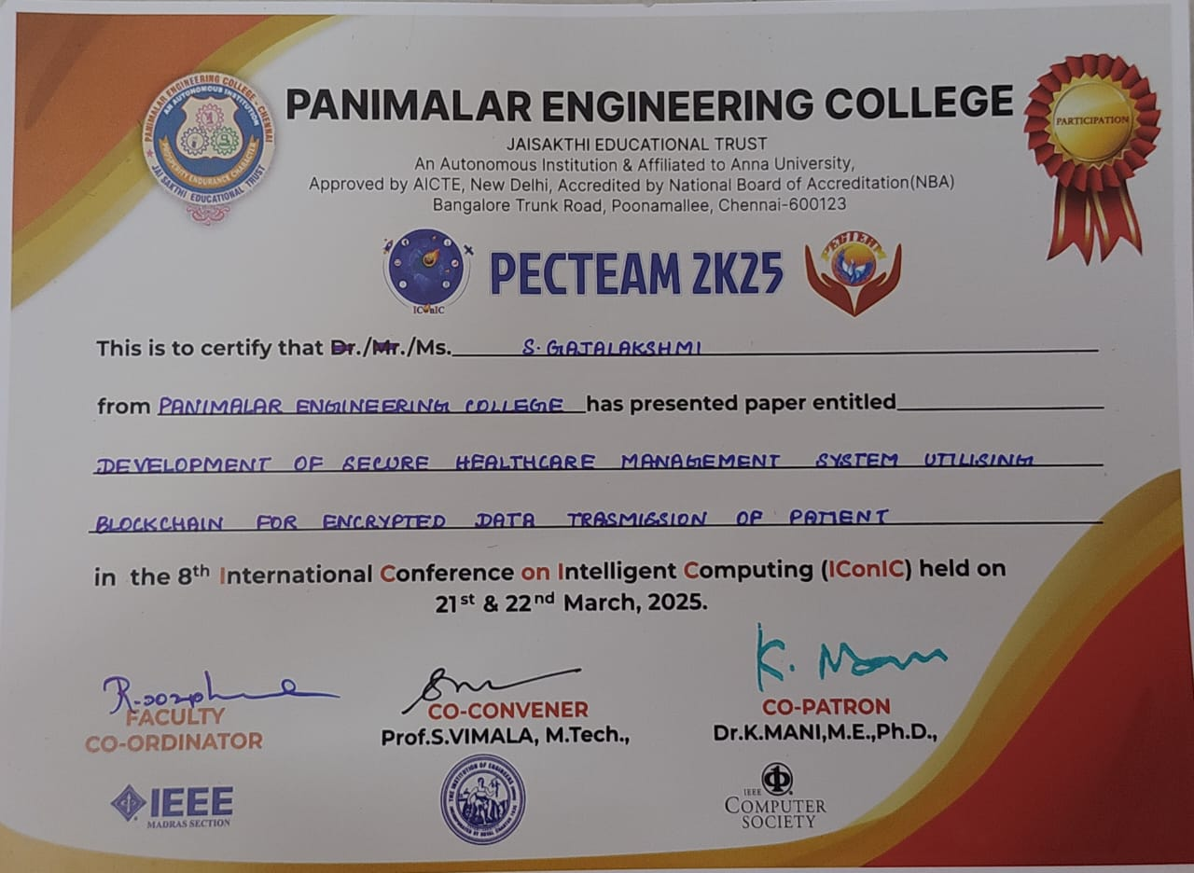
Conference Certificates

Slide 33
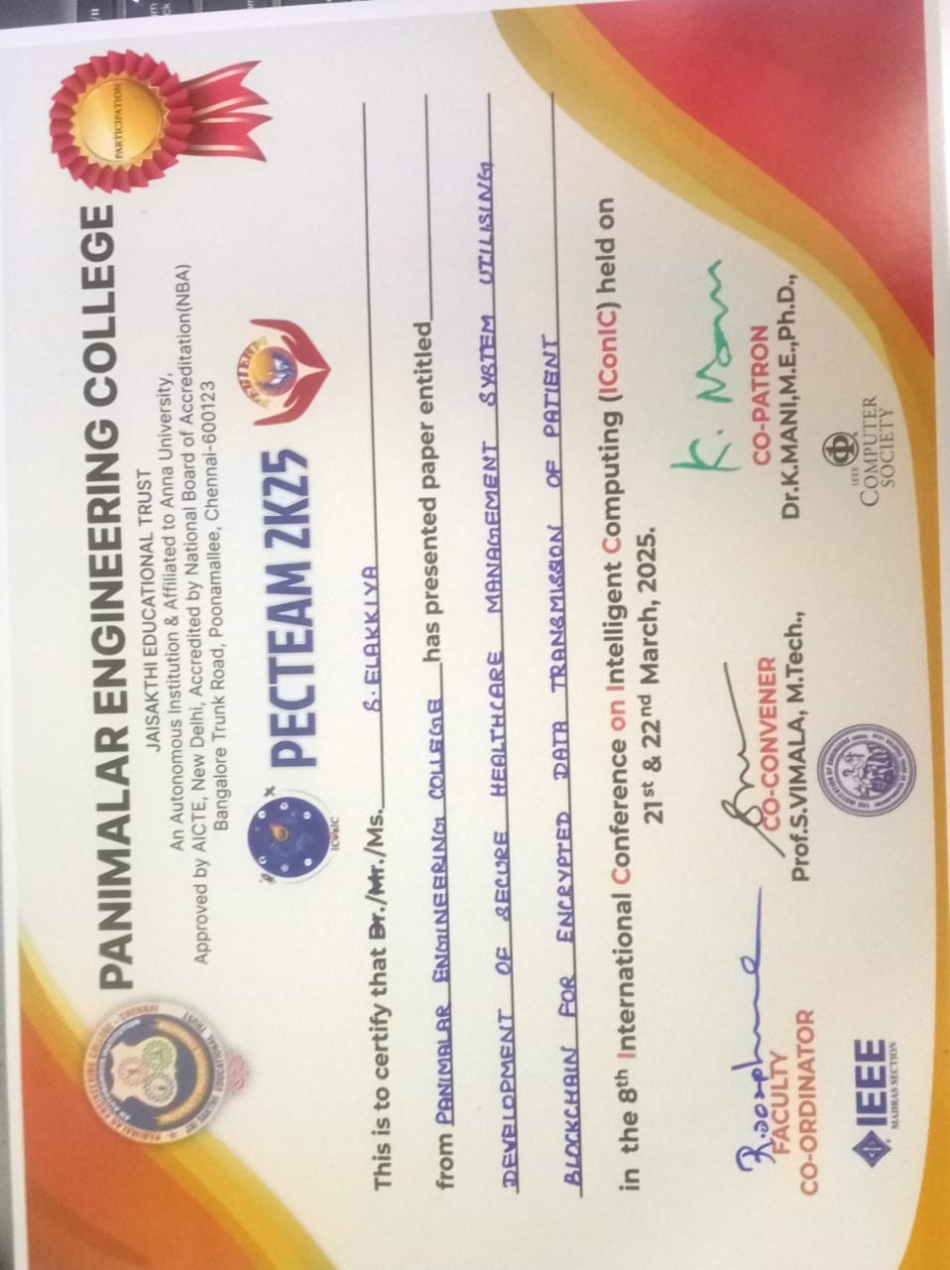
03-04-2025
DEVELOPMENT OF SECURE HEALTHCARE MANAGEMENT SYSTEM FOR UTILIZING BLOCKCHAIN TECHNOLOGY FOR ENCRYPTED PATIENT DATA TRANSMISSION

Slide 34
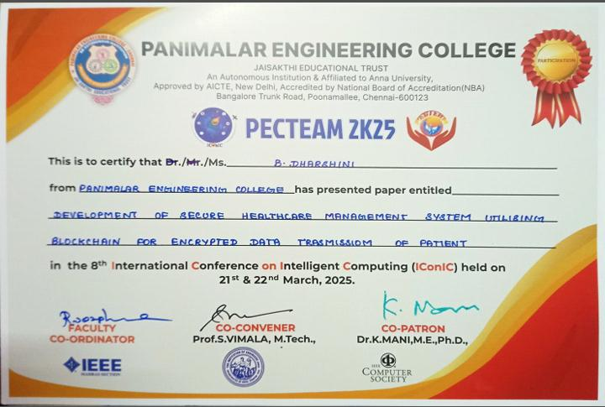
03-04-2025
DEVELOPMENT OF SECURE HEALTHCARE MANAGEMENT SYSTEM FOR UTILIZING BLOCKCHAIN TECHNOLOGY FOR ENCRYPTED PATIENT DATA TRANSMISSION

